Slide 1
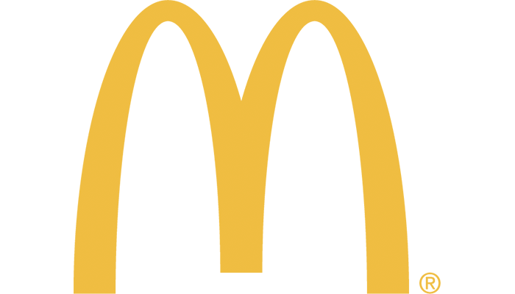
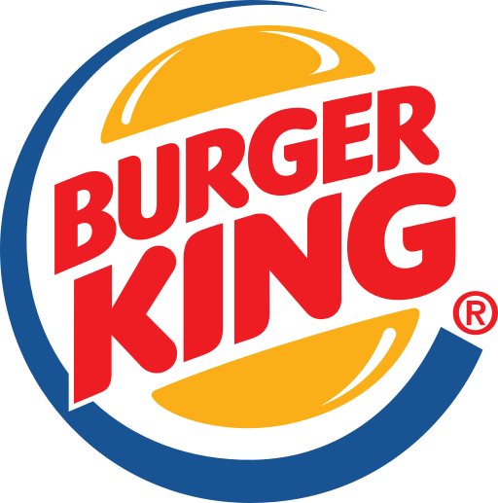

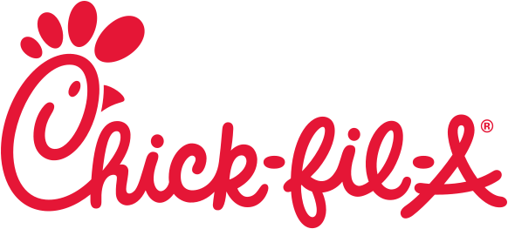
By: James Liem
Final Project: The Big Fast Food Chain War: McDonald's vs. Burger King vs. Chick-fil-A

Slide 2
Business Problem & Approach
I am interested in analyzing the social media of McDonald's, Burger King, and Chick-fil-A. I would like to analyze what people are saying about these 3 fast food companies and what these 3 companies are saying to customers. I will use Twitter as the social media source for my analyses and data collection. Using Twitter API, I am able to collect data from each company’s Twitter and the tweets mentioning them. After I collect data, I will analyze the data using many types of social media analytics such as descriptive, content, sentiment, network analytics and topic modeling (unsupervised machine learning).

Slide 3
Business Problem & Approach
In this project, I am interested in finding the answers from these questions:
What are the promotions offered through each company’s Twitter account?
What is each company mostly talking about from their tweets?
What are people saying about each company in Twitter? How is the review on Twitter?
How is the comparison between the promotions offered by each company?
What are the tweets saying?
Which fast food chain has the most positive reviews?
Which fast food chain has the most negative reviews?
Who are the top people mentioning the company?
How is the network from each company?
What are the popular topics on the reviews of each company?

Slide 4
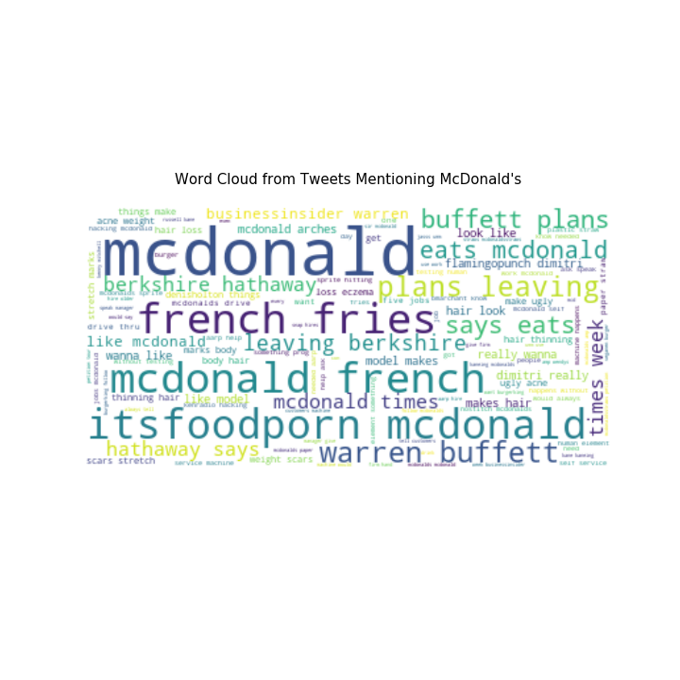
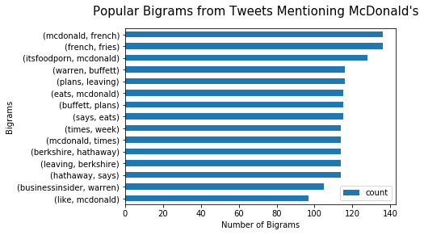
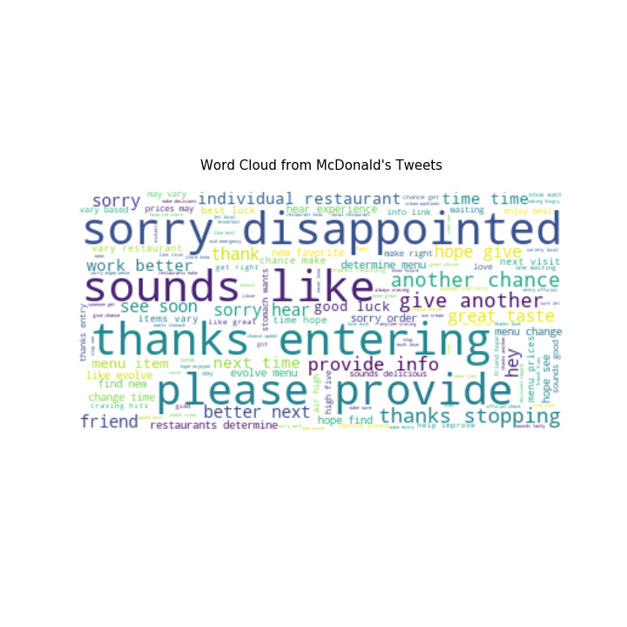
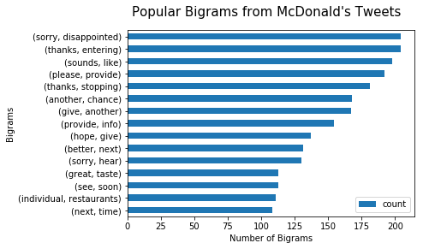
McDonald’s Twitter Analysis Findings / Results
Descriptive and Content Analysis

Slide 5
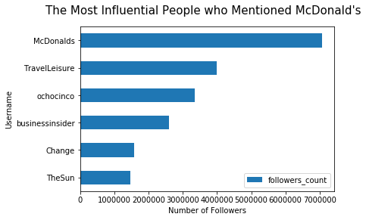
McDonald’s Twitter Analysis Findings / Results
Descriptive and Content Analysis
Notes:
It appears that the most influential username that mentioned McDonald's was a travelling company, which tweeted about international McDonald's items are coming to the US and the sentiment is pretty positive. TravelLeisure also has almost 4 million twitter followers. Fortunately, the most influential person tweeted a positive thing about McDonald's. Otherwise, it could damage McDonald's reputation.

Slide 6
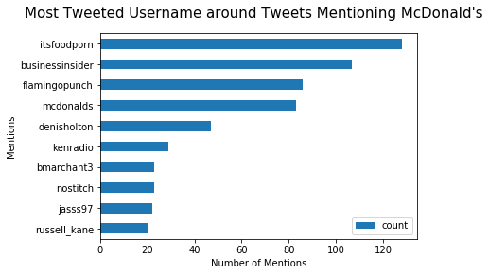
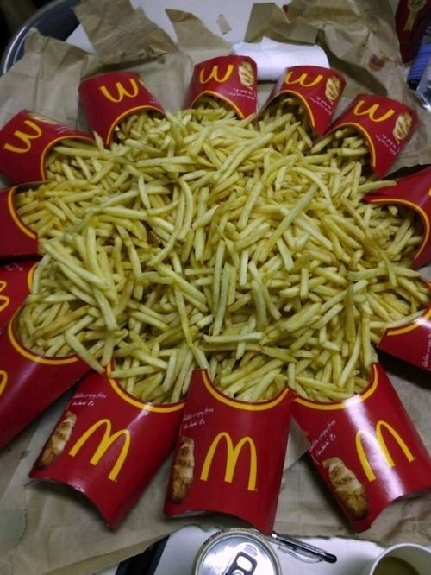
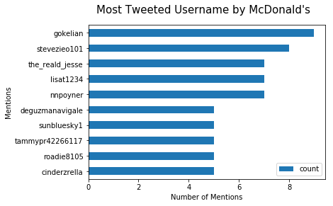
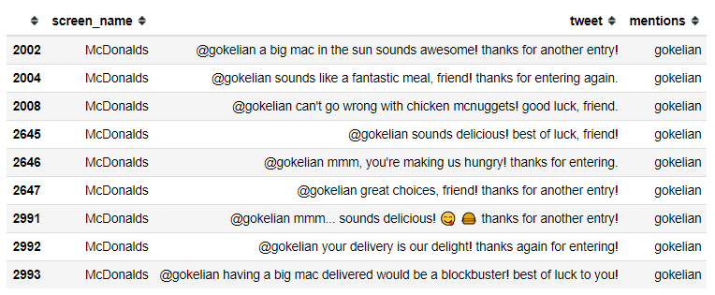
McDonald’s Twitter Analysis Findings / Results
Descriptive and Content Analysis
Notes:
It appears that people have been retweeting one same tweet by itsfoodporn. The tweet appears to be McDonald's French Fries picture. It appears that McDonald's has been replying gokelian's sweepstakes entry back.

Slide 7
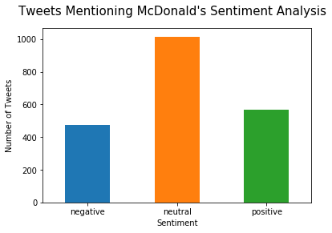
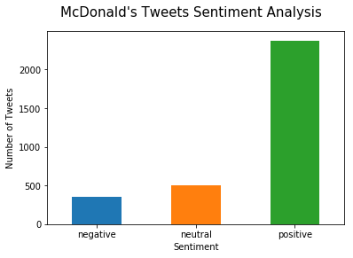
McDonald’s Twitter Analysis Findings / Results
Sentiment Analysis
Notes:
The average sentiment for tweets mentioning McDonald’s : 0.04 negative 475 neutral 1015 positive 566
The average sentiment for McDonald's tweets: 0.44 negative 354 neutral 497 positive 2373

Slide 8
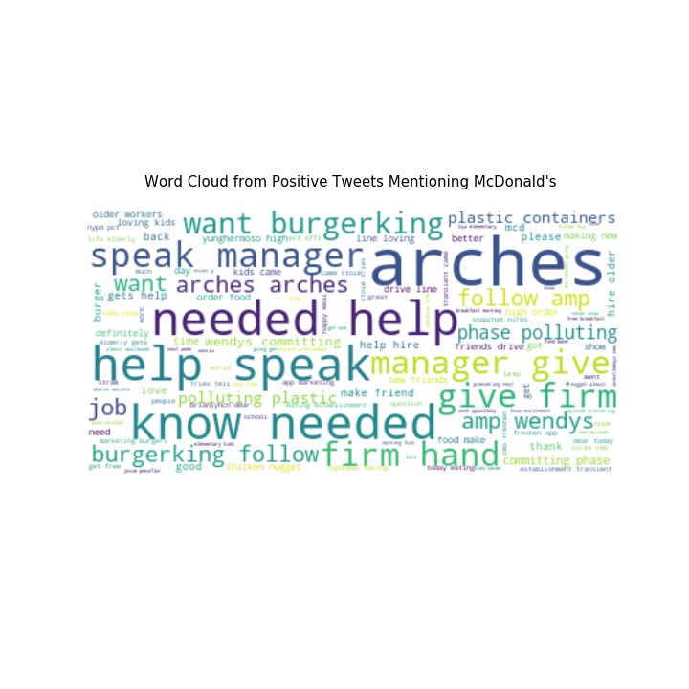
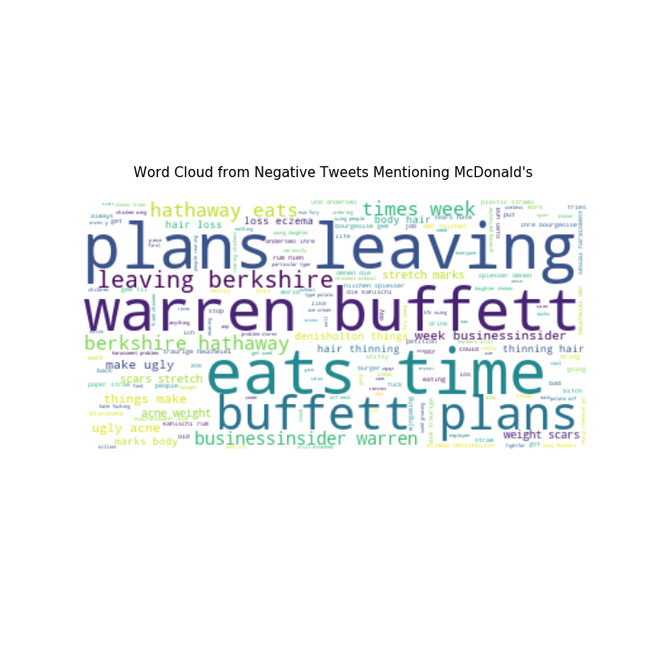
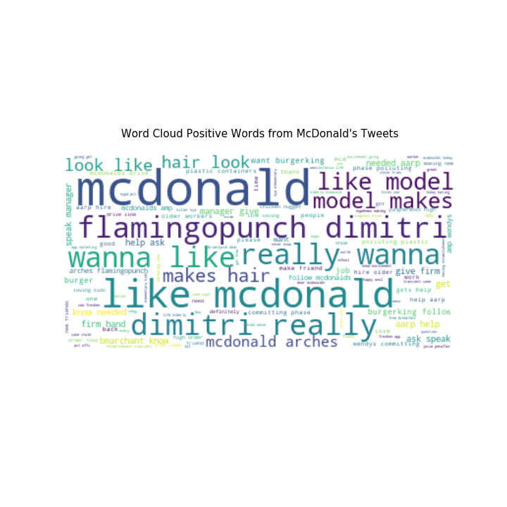
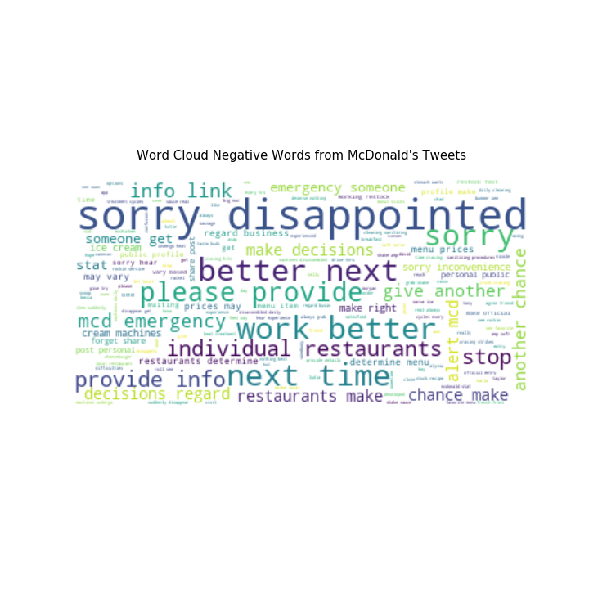
McDonald’s Twitter Analysis Findings / Results
Sentiment Analysis

Slide 9
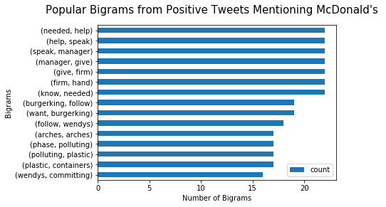
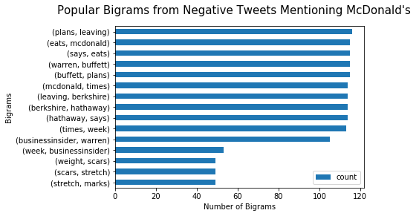
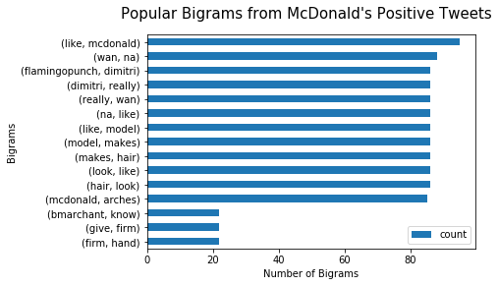
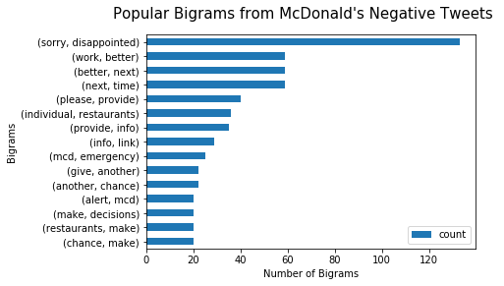
McDonald’s Twitter Analysis Findings / Results
Sentiment Analysis

Slide 10
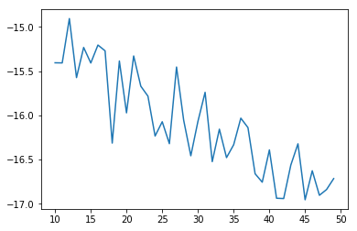
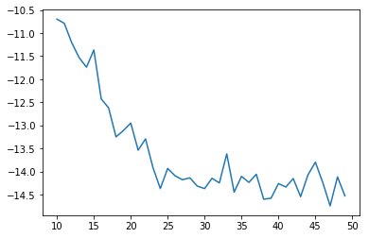
McDonald’s Twitter Analysis Findings / Results
Topic modeling using LDA
Determining optimal k-value
Tweets Mentioning McDonald's
McDonald’s Tweets
Optimal k-value: 12
Optimal k-value: 10

Slide 11
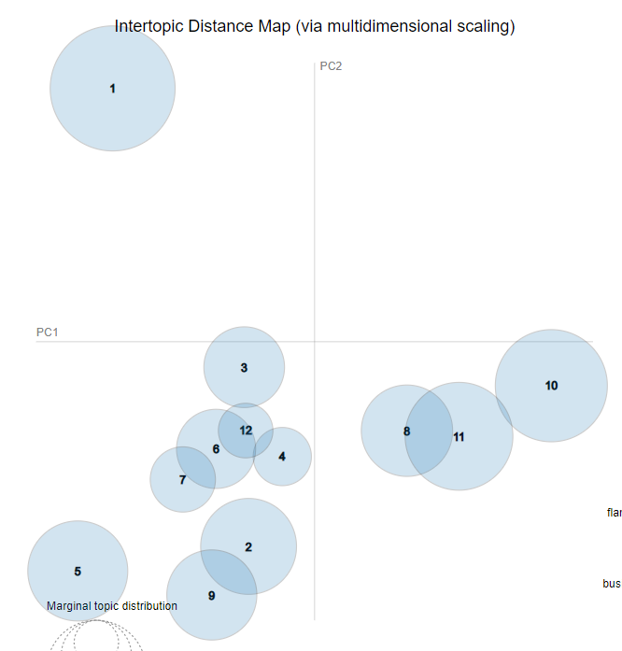
McDonald’s Twitter Analysis Findings / Results
Topic modeling using LDA
Tweets Mentioning McDonald's Topics:
French fries by itsfoodporn and Warren Buffet plans
Real people need to get job
Bring vegan burger menu
Burger King and KFC to watch games
Gaming player samsora pro life
Fried chicken wing
Calling manager and worker to help customer
Drive thru
Get going with breakfast
Flamingopunch and model dimitri hair
Wendy's lunch hair body ugly
Local night sauce
Visualization with Gensim

Slide 12
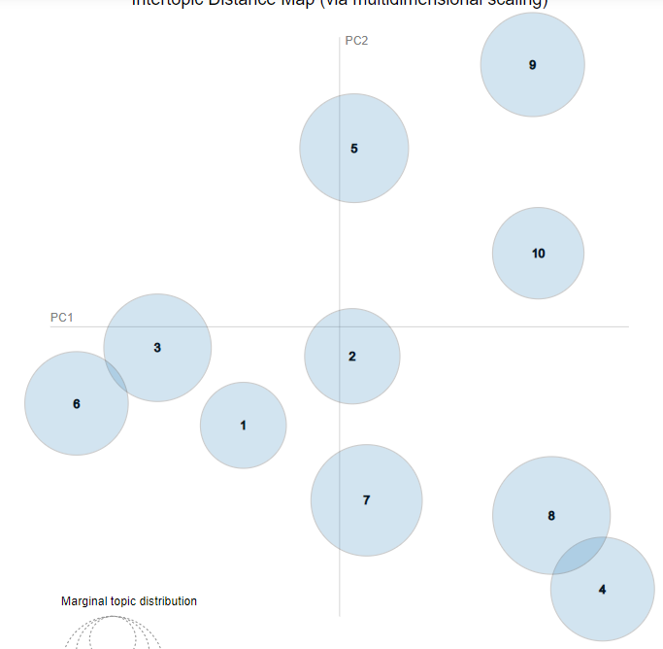
McDonald’s Twitter Analysis Findings / Results
Topic modeling using LDA
Visualization with Gensim
McDonald's Tweets Topics:
Gratitude and thanking to customers
Love someone get craving on the fries
Saying see you again soon and always craving
Sorry for something and asking for more information to help customers
Favorite menu and hoping to see some change on the menu
Thanks for entering the sweepstakes and wishing best of luck
Thanks for entering the entry and sorry for not getting the prize
Making up for mistake and handling complaints for your next visit
Menu on local restaurants vary
To make your sweepstakes entry official, please check the rule

Slide 13
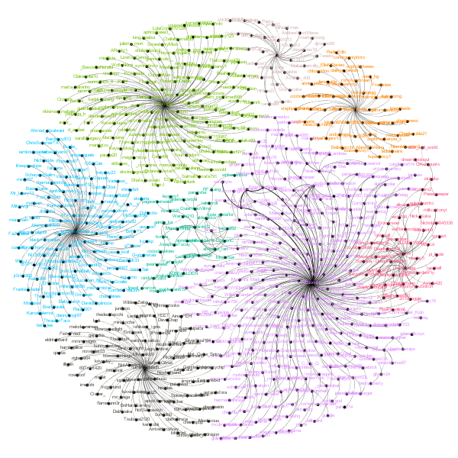
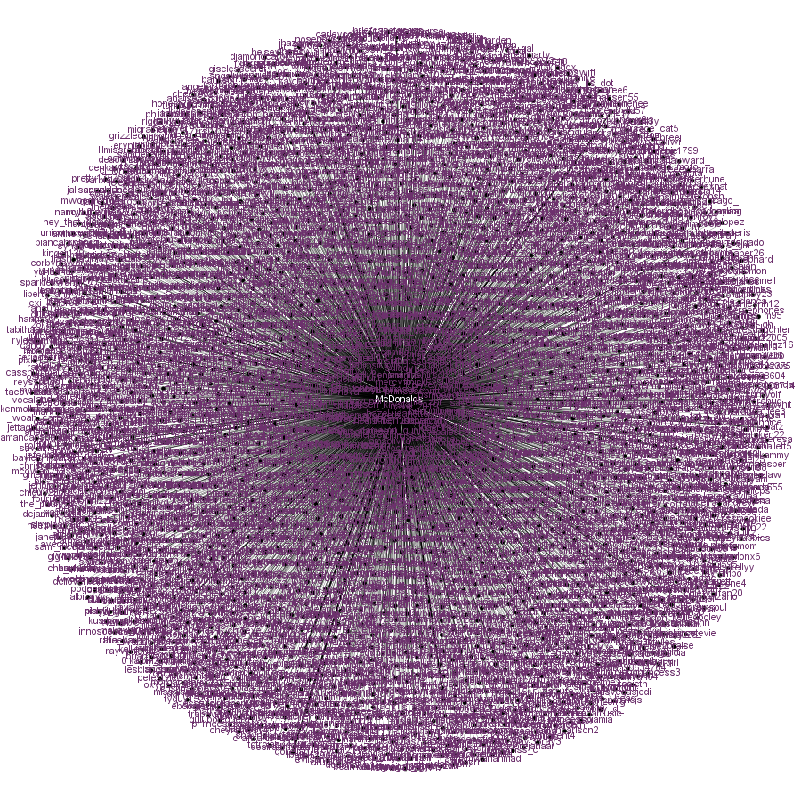
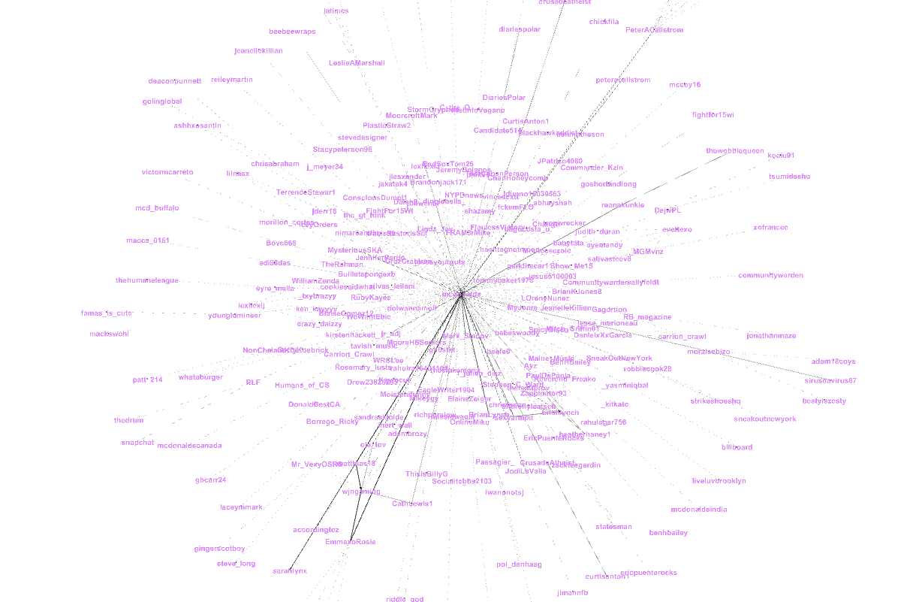
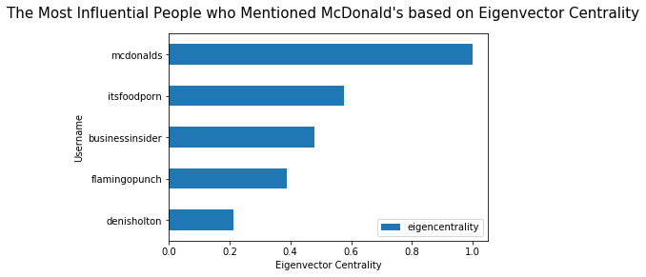
McDonald’s Twitter Analysis Findings / Results
Network Analysis

Slide 14
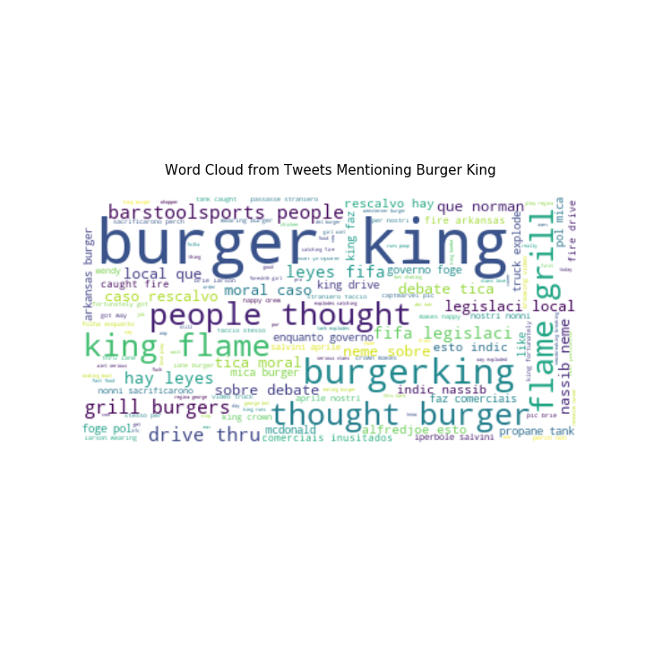
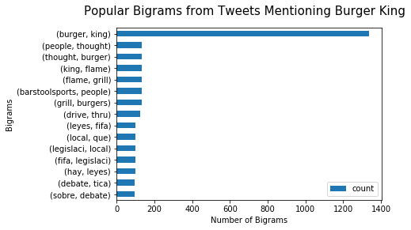
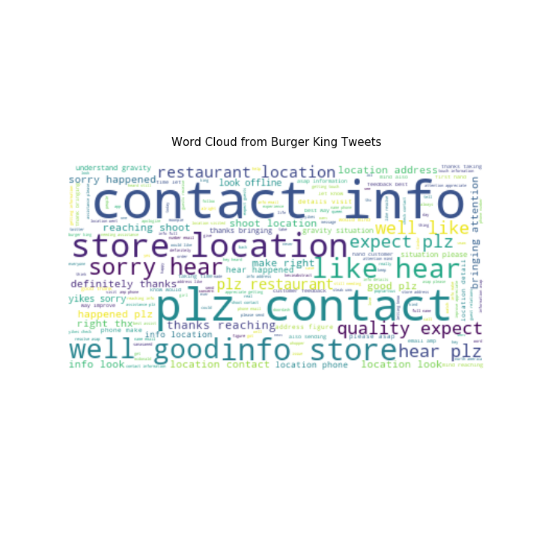
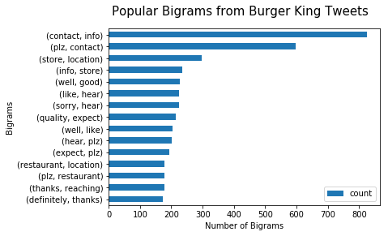
Burger King Twitter Analysis Findings / Results
Descriptive and Content Analysis

Slide 15
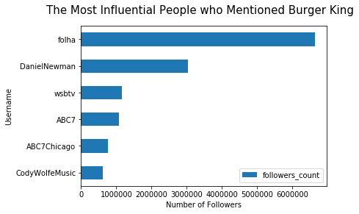
Burger King Twitter Analysis Findings / Results
Descriptive and Content Analysis
Notes:
It appears that the most influential username that mentioned Burger King was a brazillian newspaper company called folha, which tweeted about how Burger King creates unused commercials. Folha is a very influential Twitter user and has more than 6.5 million followers.

Slide 16
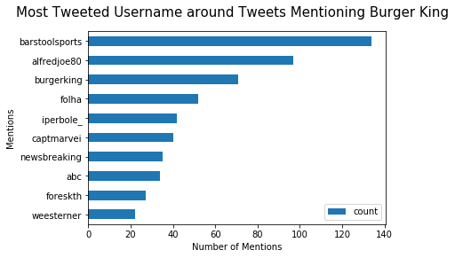
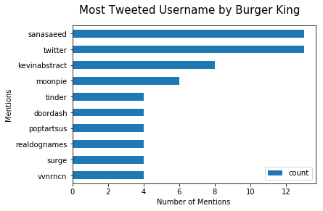
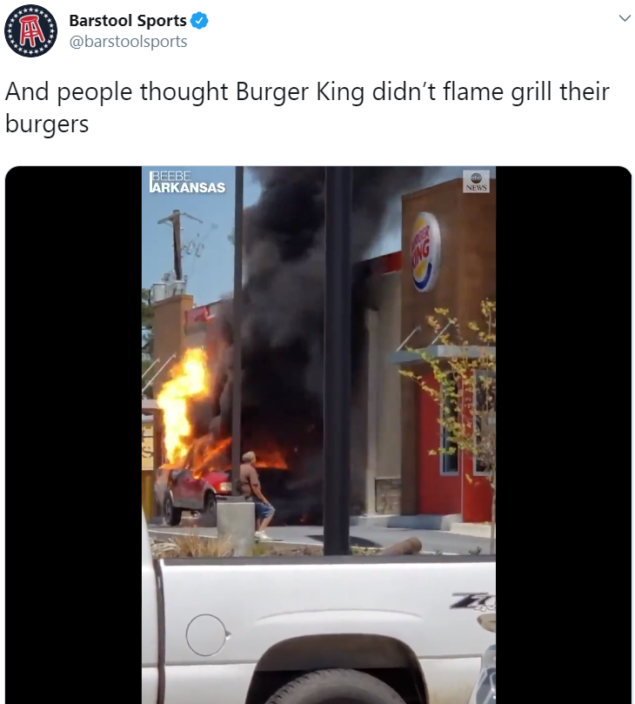
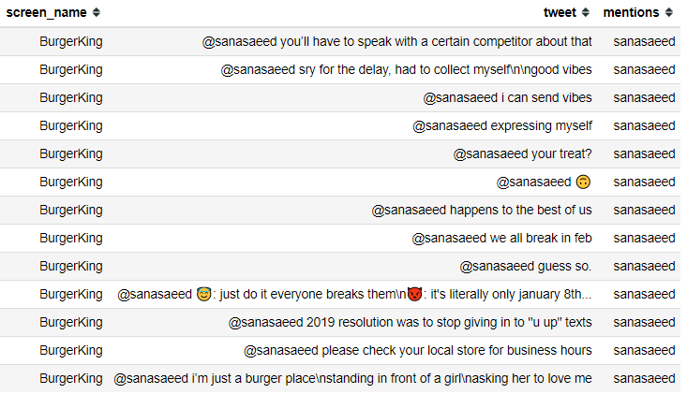
Burger King Twitter Analysis Findings / Results
Descriptive and Content Analysis
Notes:
It appears that people have been retweeting one same tweet by barstoolsports. The tweet appears to be a video with car being burned and exploded in front of a Burger King shop. It appears that Burger King has been replying back to sanasaeed for a few jokes.

Slide 17
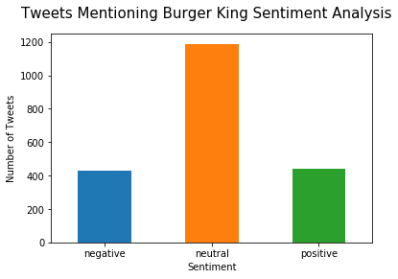
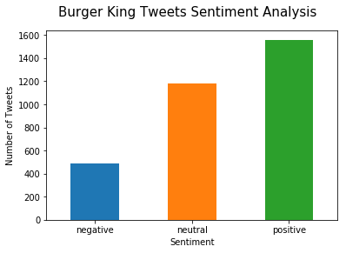
Burger King Twitter Analysis Findings / Results
Sentiment Analysis
Notes:
The average sentiment for Tweets mentioning Burger King: 0.02 negative 432 neutral 1189 positive 440
The average sentiment for Burger King tweets: 0.17 negative 488 neutral 1181 positive 1559

Slide 18
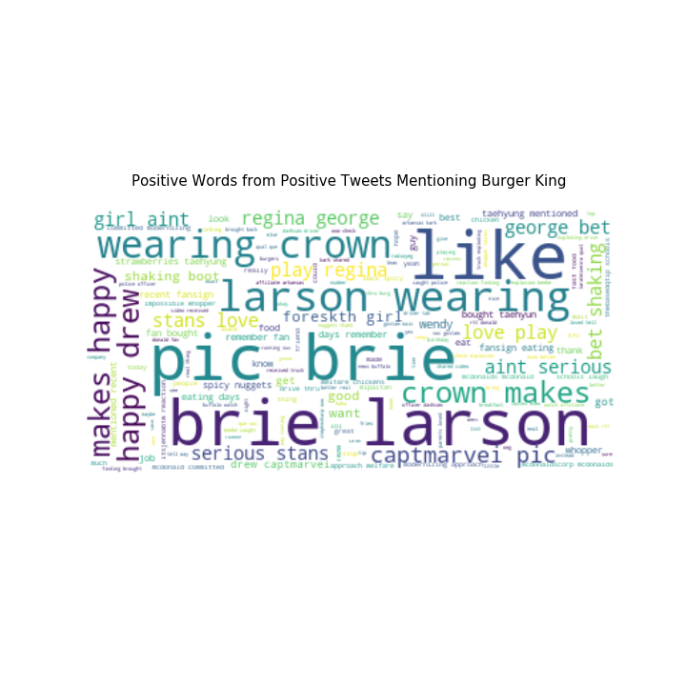
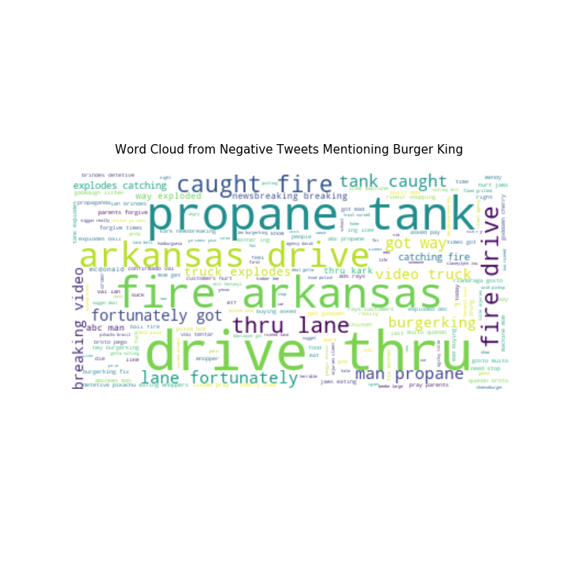
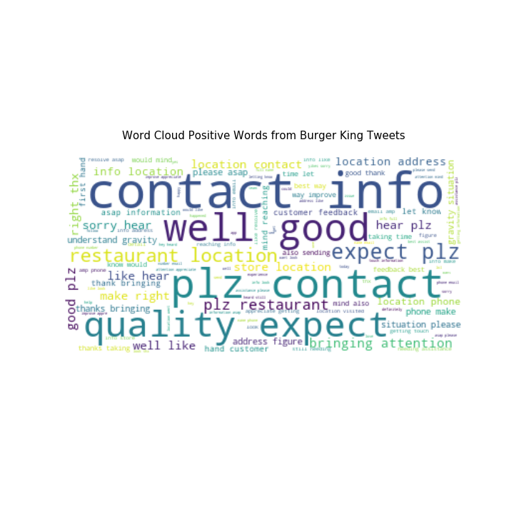
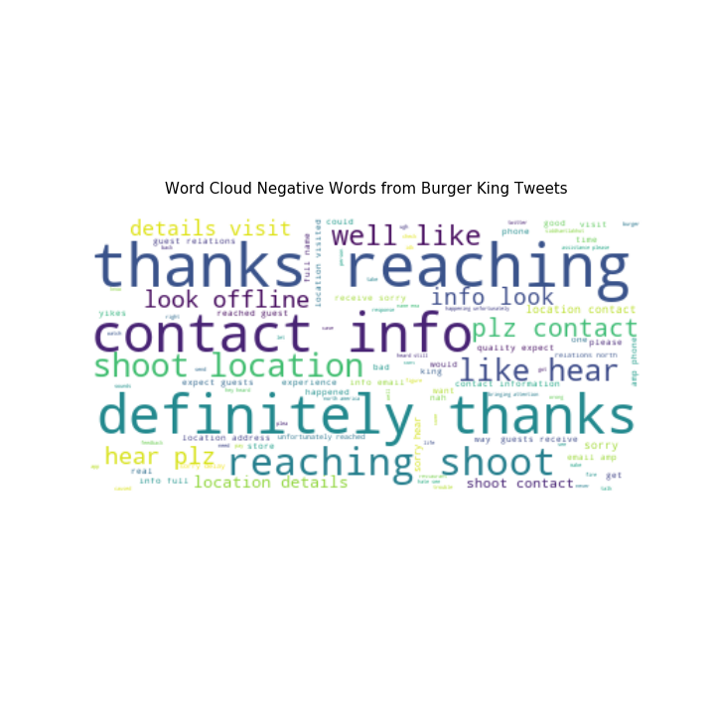
Burger King Twitter Analysis Findings / Results
Sentiment Analysis

